Slide 1
Data Communication
Introduction

Slide 2
Data Communication
Data Communication is the exchange of information from one entity to the other using a Transmission Medium.

Slide 3
Data Communication
1883: Samuel Morse & Alfred Veil invent Morse Code Telegraph System
1876: Alexander Graham Bell invented Telephone
1930: Development of ASCII Transmission Code
1950: IBM releases its first computer IBM 710
1960: IBM releases the First Commercial Computer IBM 360

Slide 4
Data Communication Definition (Modified)
Data Communication is the exchange of data (in the form of 0’s and 1’s) between two devices (computers) via some form of the transmission medium.

Slide 5

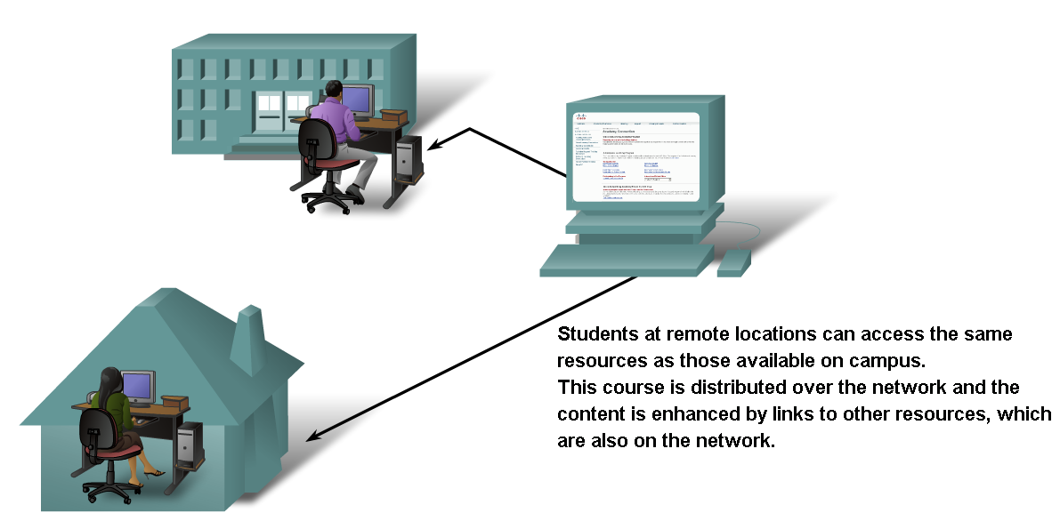
Networks supporting the way we learn.

Slide 6


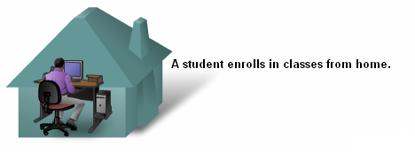

Networks supporting the way we learn.

Slide 7
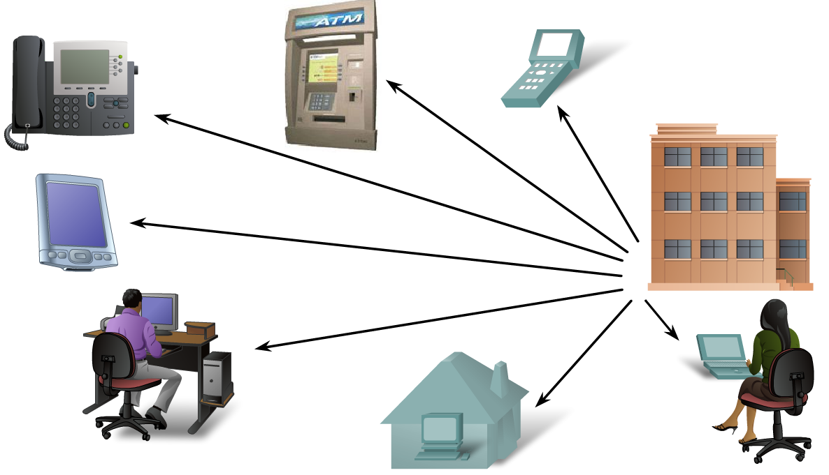
Networks supporting the way we work.

Slide 8
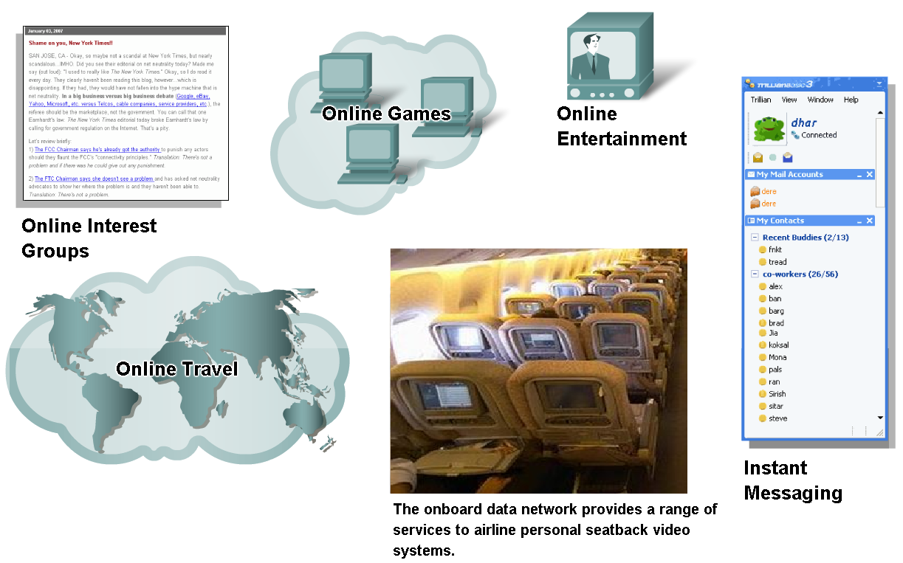
Networks supporting the way we play.

Slide 9
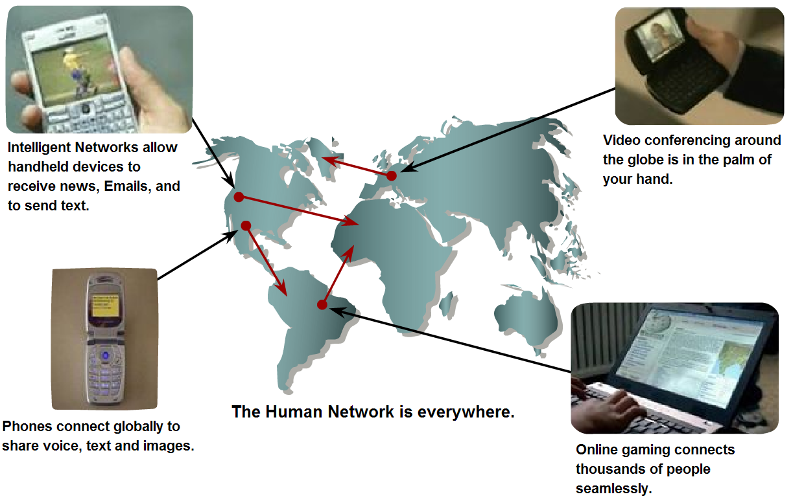
Networks- Purpose???
Communication.

Slide 10



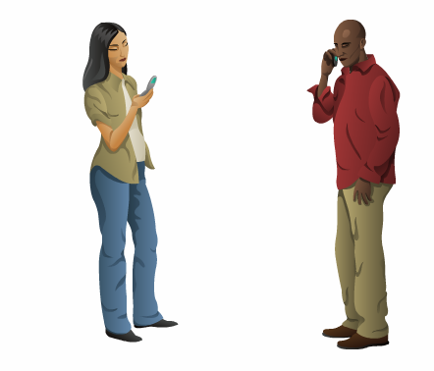
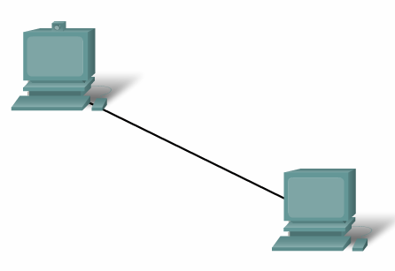

Elements of Communication

Slide 11
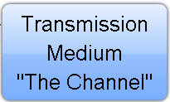




Elements of Communication
What are the elements?

Slide 12
Elements of Communication over Networks
  Devices (Sender/Receiver)
    These are used to communicate with one another
  Medium
    This is how the devices are connected together
  Messages
    Information that travels over the medium
  Rules/Protocols
    Governs how messages flow across network

Slide 13

Five elements/components of data communication
1.<number>
Notes:
1.#

Slide 14
DATA COMMUNICATION vs TELECOMMUNICATION
The term telecommunication means communication at a distance. The word data refers to information presented in whatever form is agreed upon by the parties creating and using the data. Data communications are the exchange of data between two devices via some form of transmission medium such as a wire cable.
1.<number>
Notes:
1.#

Slide 15

Data flow (simplex, half-duplex, and full-duplex)
1.<number>
Notes:
1.#

Slide 16
NETWORKS
A network is a set of devices (often referred to as nodes) connected by communication links. A node can be a computer, printer, or any other device capable of sending and/or receiving data generated by other nodes on the network.
Topics discussed in this section:
Distributed Processing
Network Criteria
Physical Structures
Network Models
Categories of Networks
Interconnection of Networks: Internetwork
1.<number>
Notes:
1.#

Slide 17

Figure 1.3 Types of connections: point-to-point and multipoint
1.<number>
Notes:
1.#

Slide 18

Figure 1.4 Categories of topology
1.<number>
Notes:
1.#

Slide 19

Figure 1.5 A fully connected mesh topology (five devices)
1.<number>
Notes:
1.#

Slide 20

Figure 1.6 A star topology connecting four stations
1.<number>
Notes:
1.#

Slide 21

Figure 1.7 A bus topology connecting three stations
1.<number>
Notes:
1.#

Slide 22

Figure 1.8 A ring topology connecting six stations
1.<number>
Notes:
1.#

Slide 23

Figure 1.9 A hybrid topology: a star backbone with three bus networks
1.<number>
Notes:
1.#

Slide 24
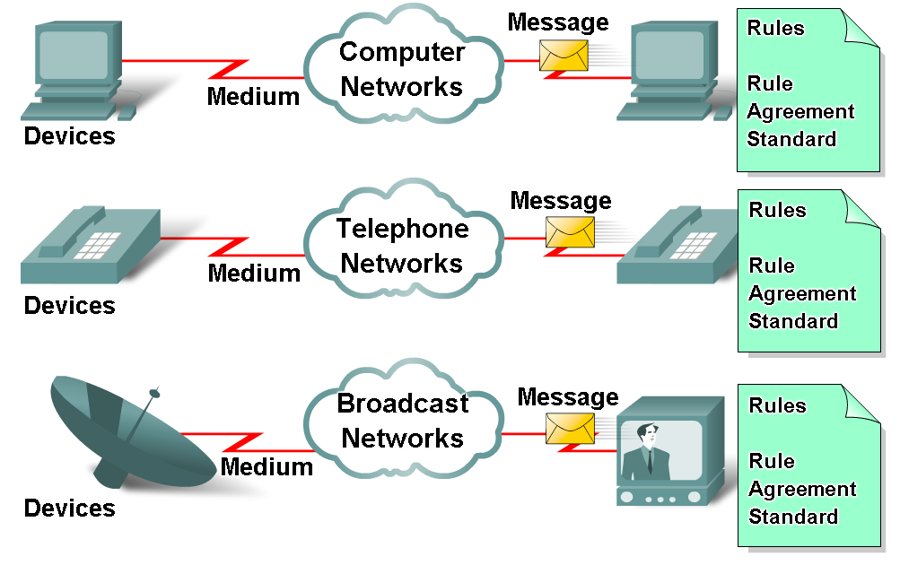
Elements of Communication over Networks

Slide 25
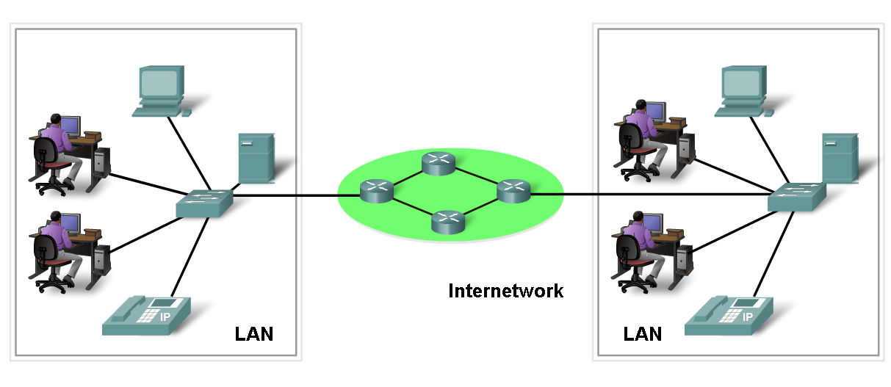
Network Elements/Components
  Network Devices
    Hardware (Devices and Media)
    Software (Services and Processes)

Slide 26
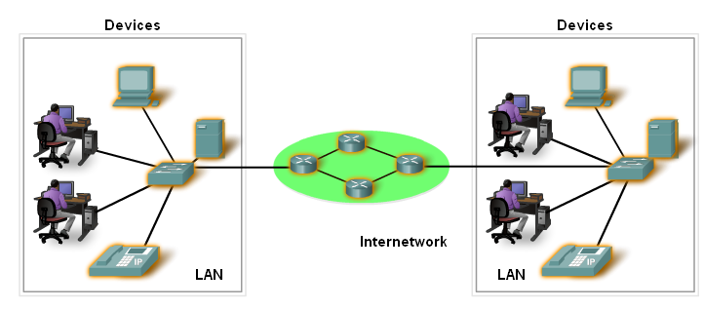
Devices
Two Types:
  End Devices
  Intermediary Devices

Slide 27
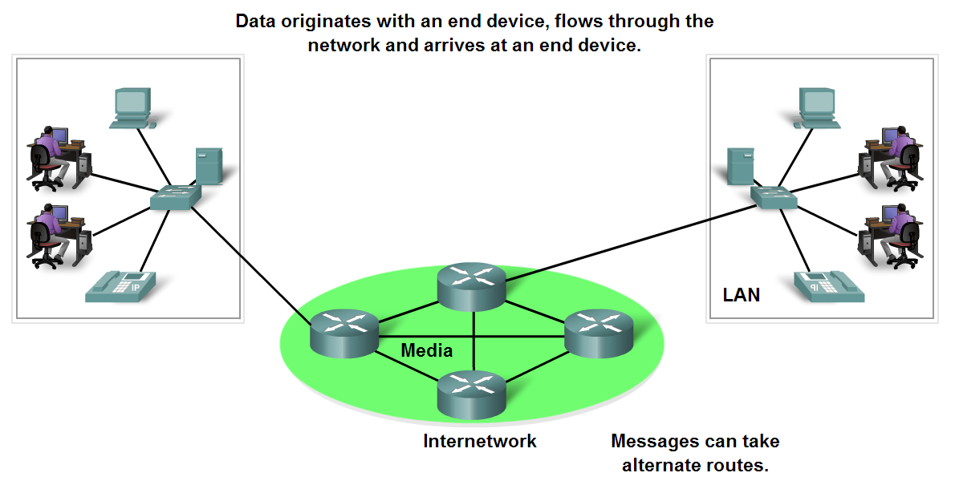
End Devices and their Role
  End devices form interface with human network & communications network

Slide 28
Intermediary devices
  Provides connectivity between end devices.
  Manages data as it flows through the network.
  Examples?
Routers
Switches

Slide 29
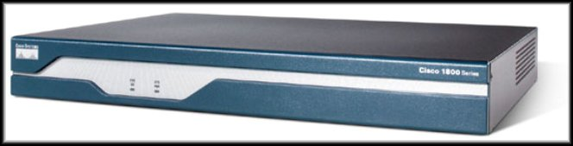
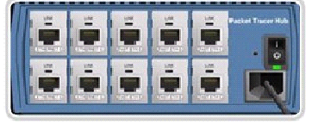
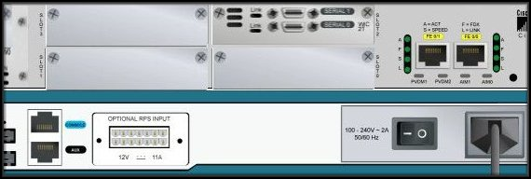
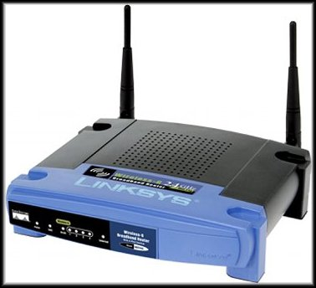

Intermediary devices
Hub
Router
Wireless Router
Switch

Slide 30
Software
Services :
  provides information in response to a request.
  For example e-mail hosting services and web hosting services.
Processes :
  Provide the functionality that directs and moves the messages through the network.
  Processes are less obvious to us but are critical to the operation of networks.

Slide 31
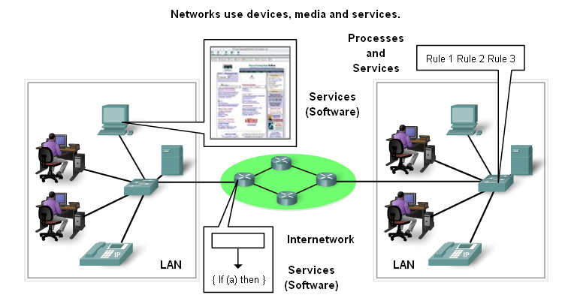
Processes and Services

Slide 32
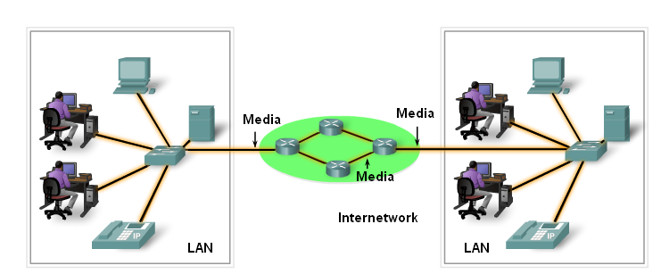
Media

Slide 33
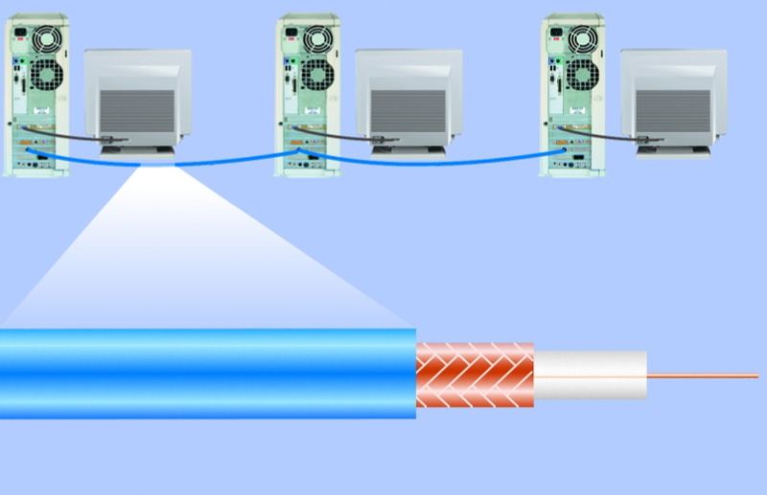
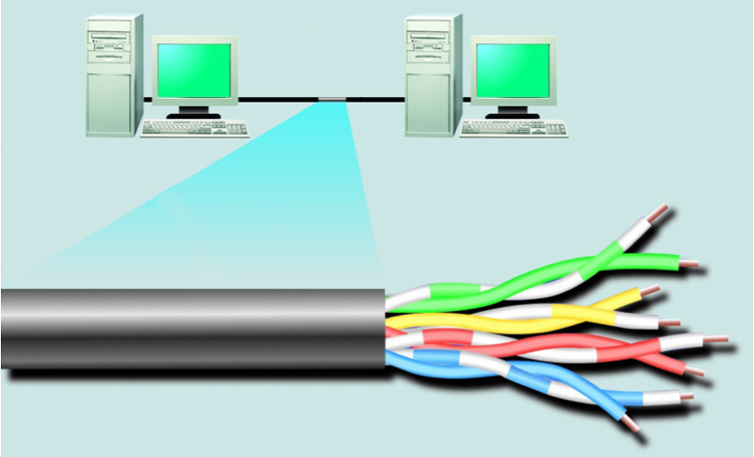
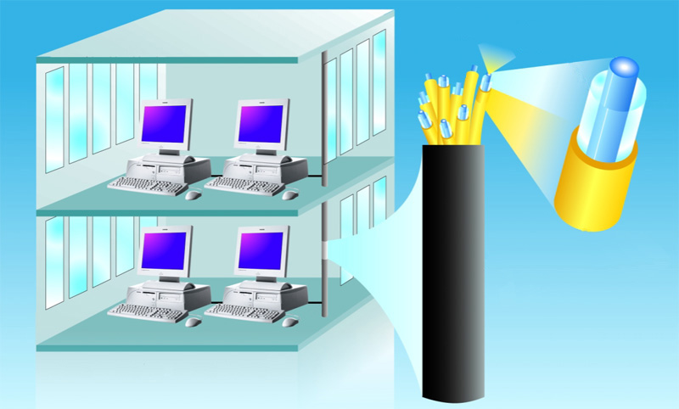
Network Media
woven or braided metal
twisted-pair cable
twisted-pair wire
copper wire
plastic outer coating
insulating material
optical fiber core
glass cladding
protective coating

Slide 34
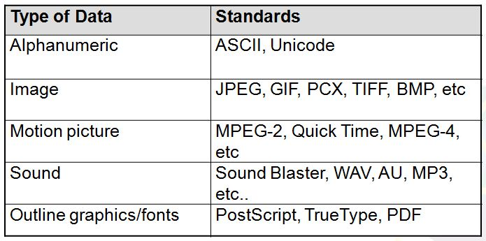
Messages- Data Representation
Information today comes in different forms such as
  text, numbers, images, audio, and video.

Slide 35
Data Representation-Text
Text : Different sets of bit patterns are designed to represent text symbols. Each set is called a code.
  ASCII
    American Standard Code for Information Interchange: 7-bit code/char, 1 bit for parity.
  Unicode - 16 bit codes to represent a symbol.

Slide 36
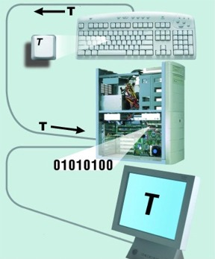
Data Representation-Text

Slide 37
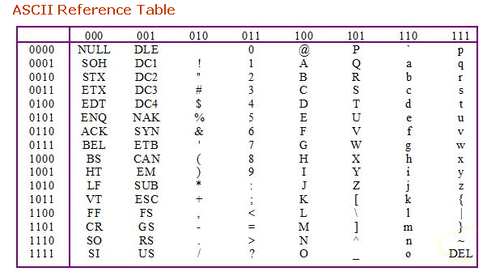
Text- Data Representation

Slide 38
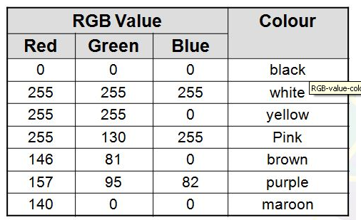
Data Representation
  Images –
    Also represented by bit patterns.
    Mechanism different. Matrix of Pixels used. Each pixel is assigned to a bit pattern.
    Color images uses RGB or YCM methods.

Slide 39
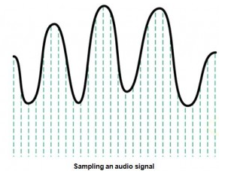
Data Representation
  Audio- Continuous, not discrete. Converted to digital or analog signal.

Slide 40
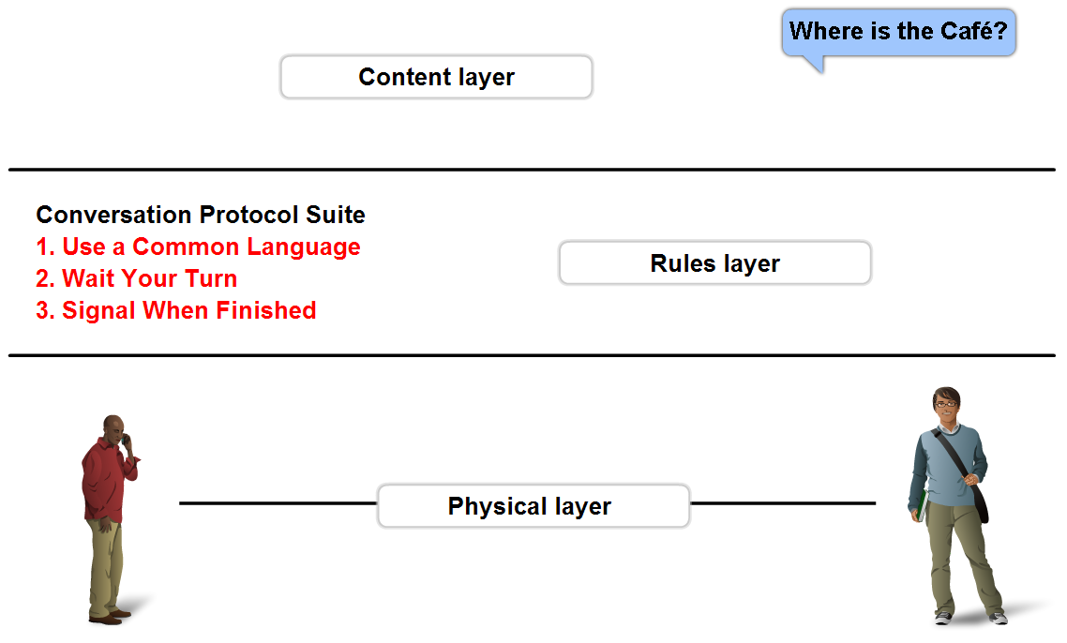
Rules - Protocols
A set of predetermined rules that govern communication.
Defines:
  What is communicated??
  How it is communicated??
  When it is communicated??

Slide 41
Network Types
PAN
LAN
MAN
WAN

Slide 42
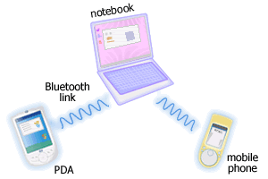
Personal Area Networks (PAN)
A network that connects computers, peripherals and other devices within a personal operating space.
Eg. Bluetooth
http://www.conniq.com

Slide 43
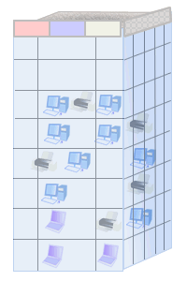
Local Area Networks (LAN)
Connects computers, peripherals and other devices within a building (e.g. office, home) or in a limited area.
Typical coverage 50 to 300 meters.
Ex. Ethernet, Wireless LANs
http://www.conniq.com

Slide 44

Metropolitan Area Network (MAN)
Is a city wide network.
The coverage limitation is not strict, but real implementation may have range of up to 50 km in urban, suburban, or rural area.
Ex. WiMax

Slide 45
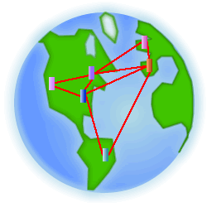
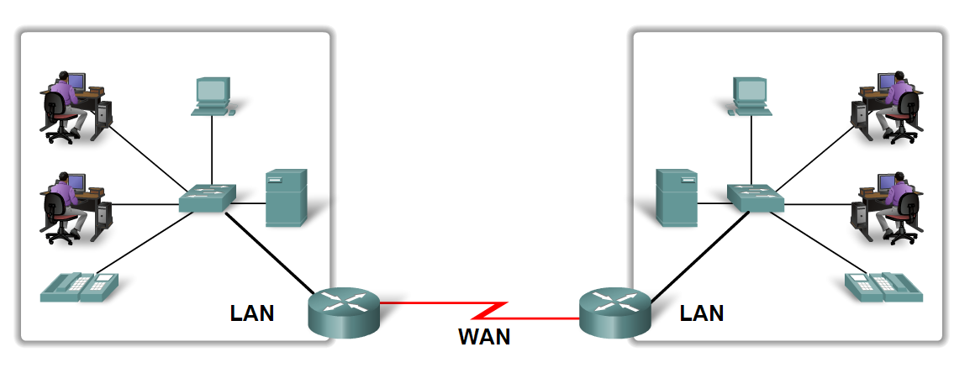
Wide Area Networks (WANs)
A network that spans larger geographical area.
LANs separated by geographic distance are connected by a Wide Area Network (WAN)
PSTN, Cellular Networks (GSM etc)

Slide 46
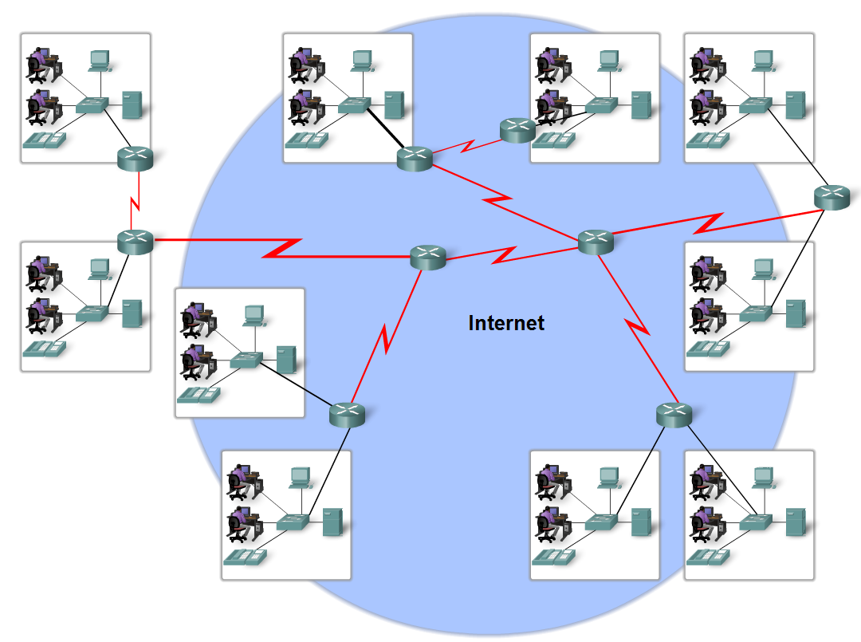
Internet
The internet is defined as a global mesh of interconnected networks.

Slide 47
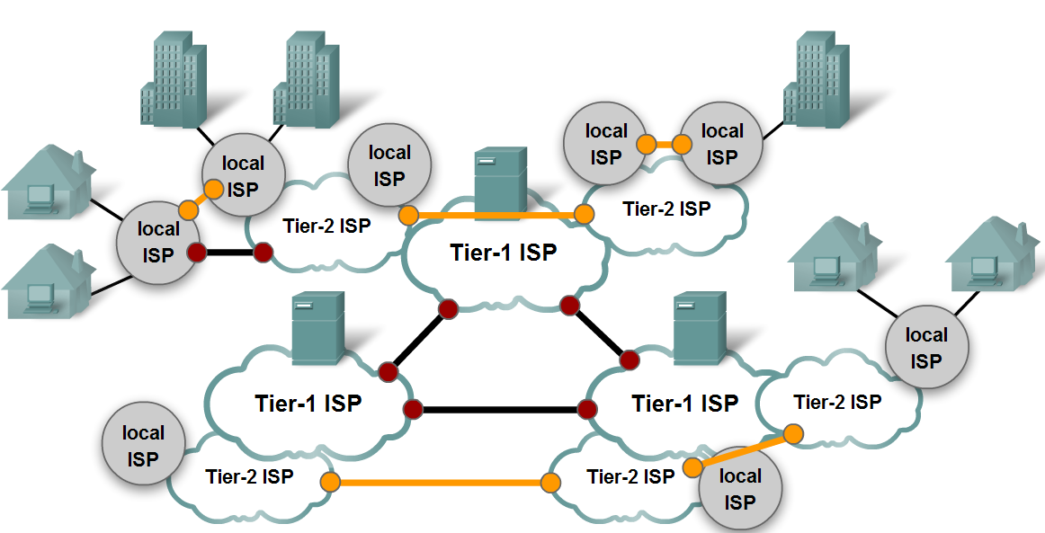
Internet

Slide 48
THE END

